Slide 1
OPERATING SYSTEMS (CS F372) Processes
Barsha Mitra
CSIS Dept., BITS Pilani, Hyderabad Campus

Slide 2
Process Concept
An operating system executes a variety of programs
Batch system – jobs
Time-shared systems – user programs or tasks
Terms job and process used interchangeably
Process – a program in execution; process execution must progress in sequential fashion

Slide 3
Process Concept
Multiple parts
The program code, also called text section
Current activity including program counter, processor registers
Stack containing temporary data
Function parameters, return addresses, local variables
Data section containing global variables
Heap containing memory dynamically allocated during run time

Slide 4
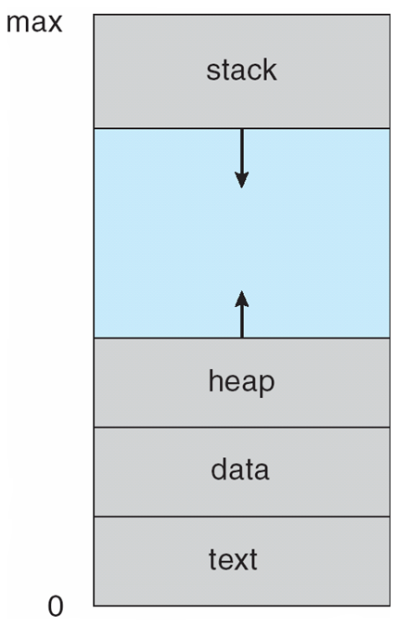
Process Concept
Program is passive entity
Process is active
Program becomes process when executable file loaded into memory
Execution of program started via GUI mouse clicks, command line entry of its name
One program can be several processes

Slide 5
States of Process
new: Process is being created
running: Instructions are being executed
waiting: Process is waiting for some event to occur
ready: Process is waiting to be assigned to a processor
terminated: Process has finished execution

Slide 6
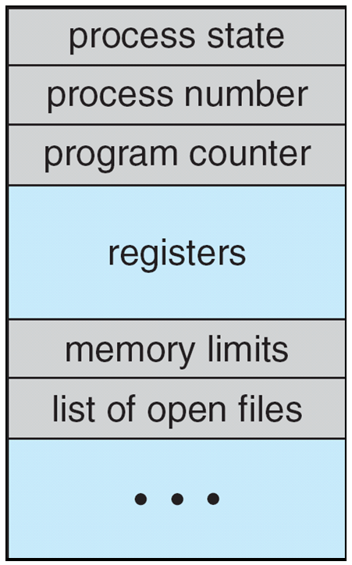
Process Control Block
Process state – new, ready, running, waiting, etc.
Program counter – location of instruction to next execute
CPU registers – contents of all process-centric registers
CPU scheduling information- priorities, scheduling queue pointers, scheduling parameters
Memory-management information – memory allocated to the process
Accounting information – CPU used, clock time elapsed since start, time limits, account nos., process nos.
I/O status information – I/O devices allocated to process, list of open files

Slide 7
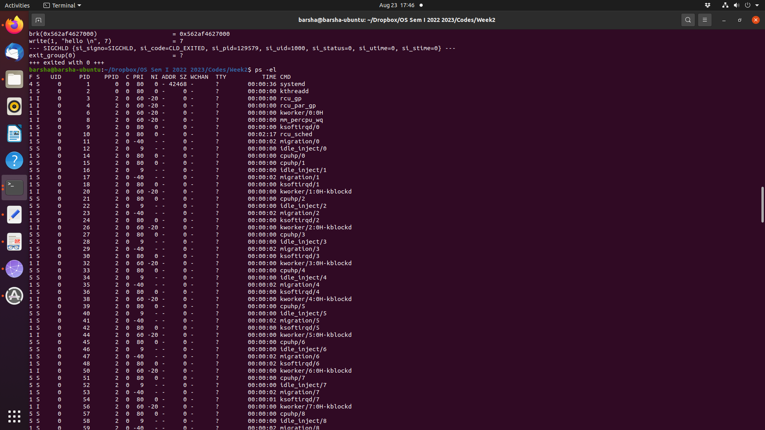

Slide 8
Process Creation
Parent process creates children processes
process identifier (pid), integer number
Resource sharing options (CPU time, memory, files, I/O devices)
Parent and children share all resources
Children share subset of parent’s resources
Parent and child share no resources
Execution options
Parent and children execute concurrently
Parent waits until children terminate

Slide 9
Process Creation
fork()
address space of child process is a copy of parent (same program and data)
both child and parent continue execution at the instruction after fork()
return code for fork() is 0 for child
return code for fork() is non-zero (child pid) for parent
exec()
loads a binary file into calling process’s memory and starts execution
destroys previous memory image
call to exec() does not return unless an error occurs
wait()
parent can issue wait() to move out of ready queue until the child is done

Slide 10
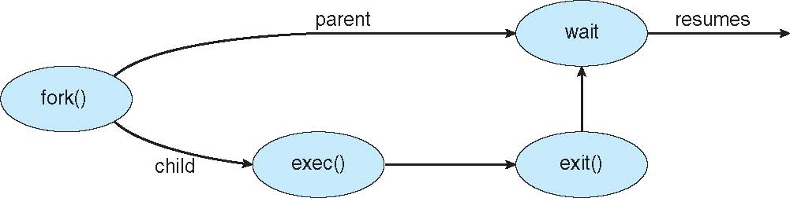
Process Creation
#include <sys/types.h>
#include <stdio.h>
#include <unistd.h>
#include<sys/wait.h>
int main()
{
pid_t pid;
pid = fork(); /* fork a child process */
if (pid < 0) { /* error occurred */
fprintf(stderr, "Fork Failed");
return 1;
}
else if (pid == 0) { /* child process */
printf("Child Process\n");
execlp("/bin/ls","ls",NULL);
}
else { /* parent process */
wait(NULL); /* parent waits for child to complete */
printf("Child Complete");
}
return 0;
}
OUTPUT:
Child Process
a.out Documents examples.desktop MyPrograms Pictures Templates
Desktop Downloads Music parent.c Public Videos
Child Complete

Slide 11
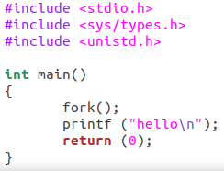
Example 1
hello
hello

Slide 12
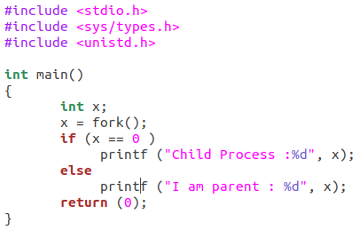
Example 2
Child Process : 0
I am Parent : 1234

Slide 13
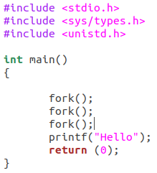
Example 3

Slide 14
Process Creation
int main()
{
pid_t pid;
pid = fork();
if (pid < 0) {
fprintf(stderr, "Fork Failed");
return 1;
}
else if (pid == 0) {
printf("Child Process\n");
printf("child pid = %d\n", getpid());
}
else {
printf("parent pid = %d\n", getpid());
wait(NULL);
printf("Child Complete");
}
return 0;
}
OUTPUT:
parent pid = 6597
Child Process
child pid = 6598
Child Complete

Slide 15
Process Creation
#include <sys/types.h>
#include <stdio.h>
#include <unistd.h>
#include<sys/wait.h>
int main()
{
pid_t pid; int x = 10;
pid = fork();
if (pid < 0) {
fprintf(stderr, "Fork Failed");
return 1;
}
else if (pid == 0) {
printf("Child Process: x = %d\n", x);
execlp("/bin/ls","ls",NULL);
}
else {
printf("Parent Process: x = %d\n", x);
wait(NULL);
printf("Child Complete");
}
return 0;
}
OUTPUT:
Parent Process: x = 10
Child Process: x = 10
a.out Documents examples.desktop MyPrograms Pictures Templates
Desktop Downloads Music parent.c Public Videos
Child Complete

Slide 16
Process Creation
int main()
{
pid_t pid;
int x = 10;
pid = fork();
if (pid < 0) {
fprintf(stderr, "Fork Failed");
return 1;
}
else if (pid == 0) {
x = x + 10;
printf("Child Process: x = %d\n", x);
}
else {
wait(NULL);
printf("Parent Process: x = %d\n", x);
printf("Child Complete");
}
return 0;
}
OUTPUT:
Child Process: x = 20
Parent Process: x = 10
Child Complete

Slide 17
Process Termination
exit() system call
child can return status data to parent (via wait())
resources are deallocated by operating system
parent may terminate the execution of children
cascading termination - all children, grandchildren, etc. are terminated
pid_t pid;
int status;
pid = wait(&status); //parent can tell which child has terminated
If no parent waiting (did not invoke wait() till then) process is a zombie
If parent terminated, process is an orphan

Slide 18
Zombie Process
int main()
{
pid_t child_pid = fork();
if (child_pid > 0) {
sleep(10);
wait(NULL);
sleep(200);
}
else{
printf("\n%d",getpid());
exit(0);
}
return 0;
}
zombie
no longer a zombie
F S UID PID PPID C PRI NI ADDR SZ WCHAN TTY TIME CMD
1 Z 1001 17404 17403 0 80 0 - 0 - pts/0 00:00:00 a.out <defunct>

Slide 19
Orphan Process
int main()
{
pid_t child_pid = fork();
if (child_pid > 0){
printf("\nParent process: %d\n",getpid());
sleep(6);
}
else{
printf("\nParent PID: %d\n",getppid());
sleep(20);
printf("\nChild Process: %d",getpid());
printf("\nParent PID: %d",getppid());
exit(0);
}
return 0;
}

Slide 20
Interprocess Communication
Processes may be independent or cooperating
Cooperating process can affect or be affected by other processes, including sharing data
Cooperating processes need interprocess communication (IPC)
Pipes
Shared memory
Message passing

Slide 21
Pipe
Acts as a conduit allowing two processes to communicate
Half-duplex and full-duplex
Ordinary pipes –
one-way communication
What about two-way communication?
cannot be accessed from outside the process that created it
parent process creates a pipe and uses it to communicate with a child process
Named pipes – can be accessed without a parent-child relationship

Slide 22
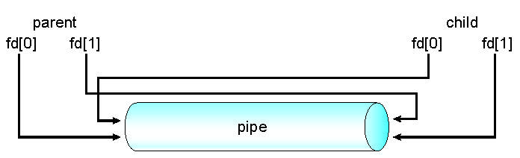
Ordinary Pipe
One process writes to one end (write-end)
Another process reads from the other end (read-end)
Require parent-child relationship between communicating processes
Windows calls these anonymous pipes
ordinary pipe can’t be accessed from outside the process that created it
child inherits the pipe from its parent process like any other file

Slide 23
Ordinary Pipe

Slide 24
Named Pipe
Named Pipes are more powerful than ordinary pipes
Communication is bidirectional
No parent-child relationship required between communicating processes
Several processes can use the named pipe for communication
Does not cease to exist if the communicating processes have terminated
Provided on both UNIX and Windows systems
Referred to as FIFOs in UNIX systems

Slide 25
Interprocess Communication
message passing shared memory

Slide 26
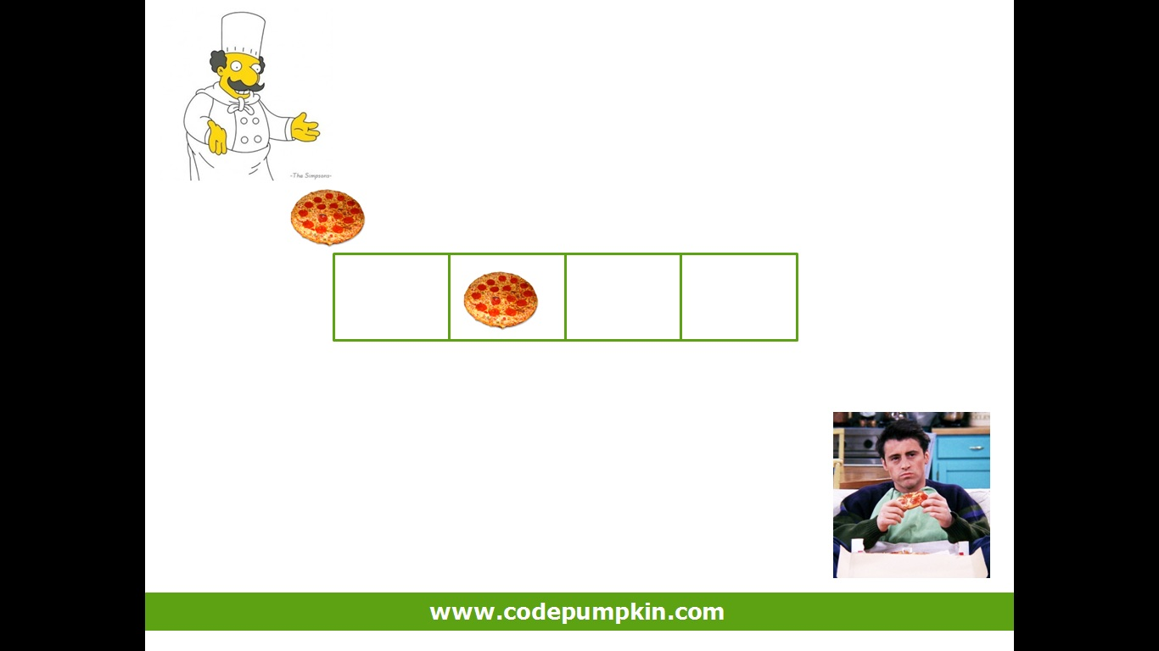
Producer-Consumer Problem

Slide 27
IPC – Shared Memory
area of memory shared among cooperating processes
create shared memory
attach to shared memory
shared memory region resides in address space of creating process
faster than message passing
system calls are required to establish shared memory region
synchronization

Slide 28
Producer-Consumer Problem
Shared data, reside in a region of memory shared by producer & consumer
#define BUFFER_SIZE 10
typedef struct {
. . .
} item;
item buffer[BUFFER_SIZE];
int in = 0;
int out = 0;

Slide 29
Bounded Buffer - Producer
item next_produced;
while (true) {
/* produce an item in next produced */
while (((in + 1) % BUFFER_SIZE) == out) //buffer is full
; /* do nothing */
buffer[in] = next_produced;
in = (in + 1) % BUFFER_SIZE;
}
Producer
item next_consumed;
while(true){ while (in == out) //buffer is empty
; /*do nothing*/
next_consumed = buffer[out];
out = (out + 1) % BUFFER_SIZE;
/* consume the item in next consumed */
}
Consumer

Slide 30
IPC – Message Passing
mechanism for processes to communicate and synchronize their actions
no sharing of address space
2 operations:
send(message)
receive(message)
message size is either fixed or variable

Slide 31
Message Passing – Direct Communication
Processes must name each other explicitly:
send (P, message) – send a message to process P
receive(Q, message) – receive a message from process Q
Links are established automatically
A link is associated with exactly one pair of communicating processes
Between each pair there exists exactly one link

Slide 32
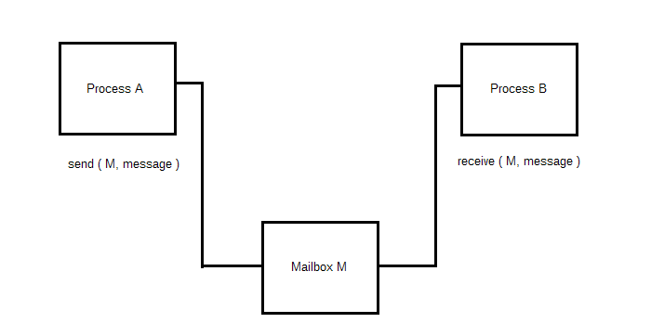
Message Passing – Indirect Communication
Messages are directed and received from mailboxes / ports
Each mailbox has a unique ID
Processes can communicate only if they share a mailbox
Link is established only if processes share a common mailbox
A link may be associated with many processes
Each pair of processes may share several communication links, each link corresponds to one mailbox

Slide 33
Message Passing – Indirect Communication
Operations
create a new mailbox (port)
send and receive messages through mailbox
destroy a mailbox
send(A, message) – send a message to mailbox A
receive(A, message) – receive a message from mailbox A

Slide 34
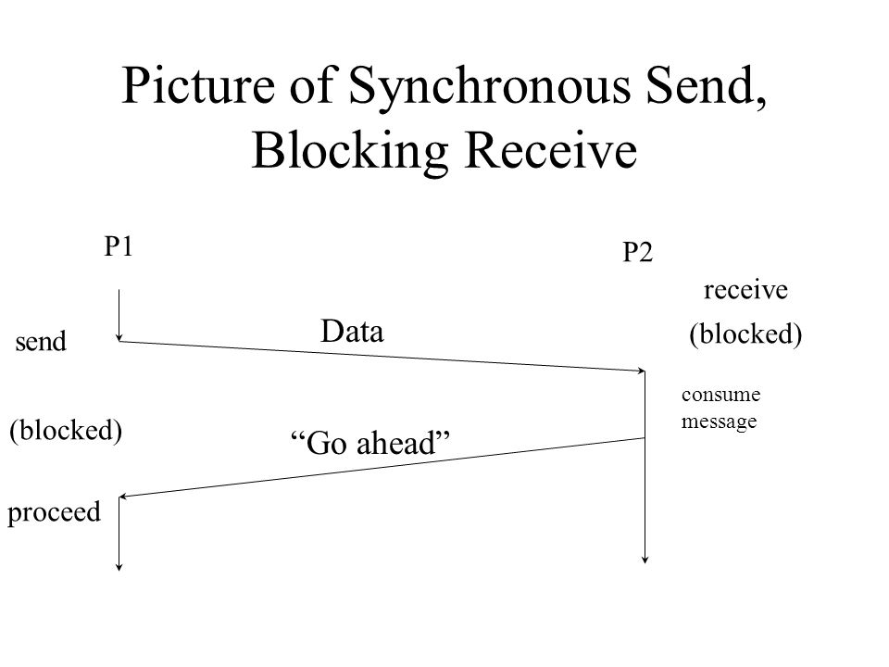
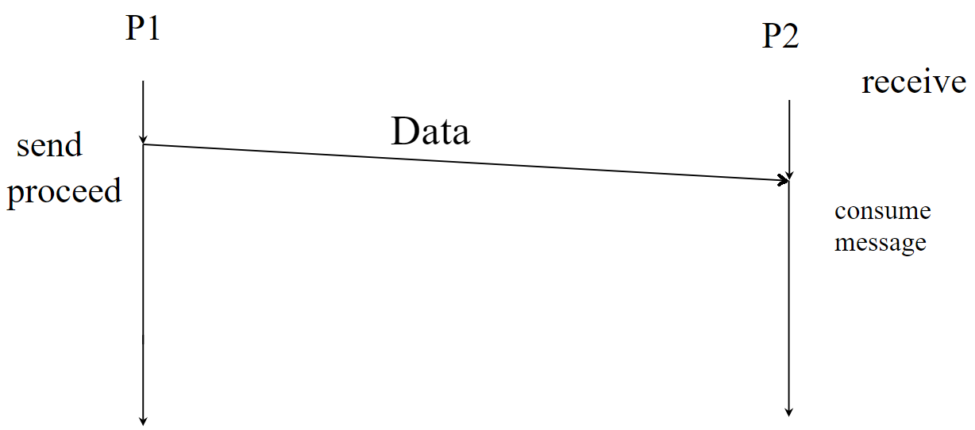
Synchronization
Blocking / synchronous
Blocking send -- sender is blocked until the message is received by the receiving process or mailbox
Blocking receive -- receiver is blocked until a message is available
Non-blocking / asynchronous
Non-blocking send -- sender sends the message and continues
Non-blocking receive -- receiver receives a valid message or null message
https://slideplayer.com/slide/8673888/

Slide 35
Buffering
messages exchanged by processes reside in a temporary queue
Zero capacity Queue
Bounded capacity Queue
Unbounded capacity Queue

Slide 36
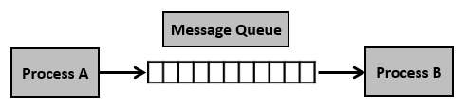
Message Queue
asynchronous communication
messages placed onto the queue are stored until the recipient retrieves them
Step 1 − Create a message queue or connect to an already existing message queue (msgget())
Step 2 − Write into message queue (msgsnd())
Step 3 − Read from the message queue (msgrcv())
Step 4 − Perform control operations on the message queue (msgctl())

Slide 37


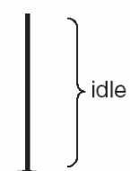

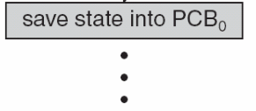
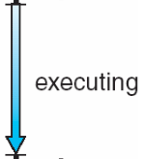

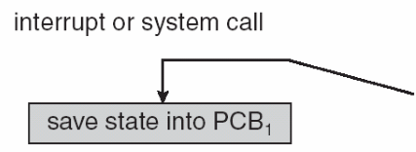

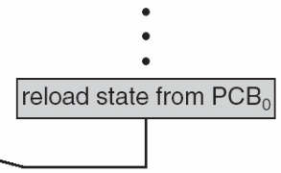
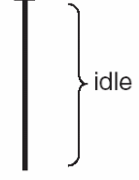

Context Switch
System must save state of the old process and load the state for the new process via context switch
Context of a process represented in PCB (CPU registers contents, process state, memory management info.)
Context-switch time is overhead
Time dependent on hardware support

Slide 38
Process Scheduling
Process scheduler selects among available processes for next execution on CPU
Maintains scheduling queues of processes
Job queue – set of all processes in the system
Ready queue – set of all processes residing in main memory, ready and waiting to execute, can be stored as a linked list
Device queues – set of processes waiting for an I/O device
Processes migrate among the various queues

Slide 39
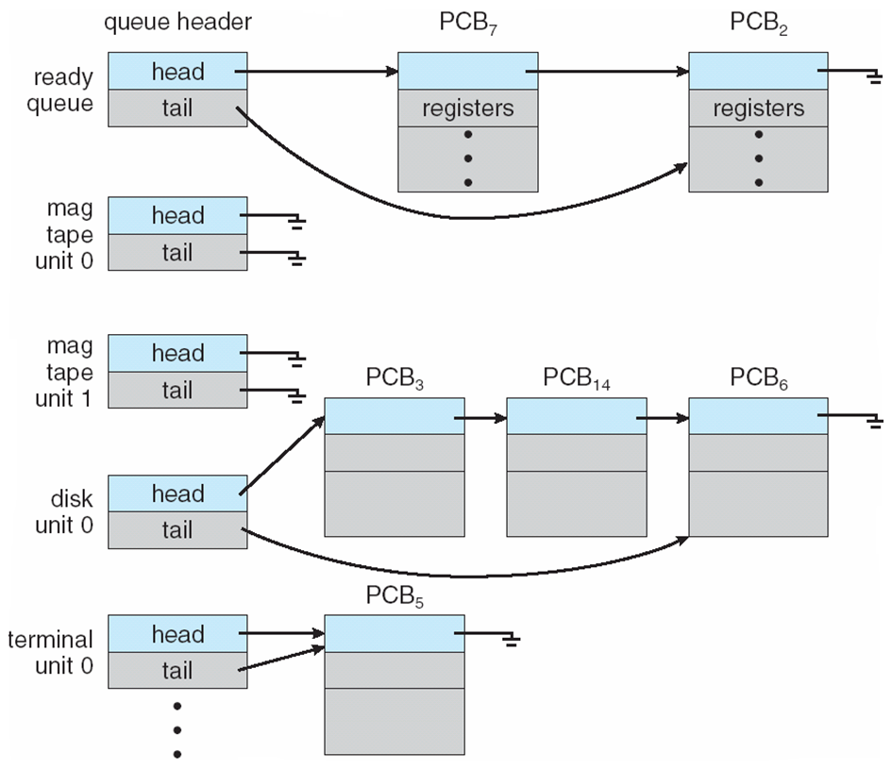
Various Queues

Slide 40
Schedulers
Short-term scheduler (CPU scheduler) – selects which process should be executed next and allocated the CPU
invoked frequently (milliseconds) ⇒ (must be fast)
Long-term scheduler (job scheduler) – selects which processes from job queue should be brought into the ready queue
invoked infrequently (seconds, minutes) ⇒ (may be slow)
controls degree of multiprogramming (no. of processes in main memory)
Processes can be
I/O-bound process
CPU-bound process
Long-term scheduler strives for good process mix

Slide 41
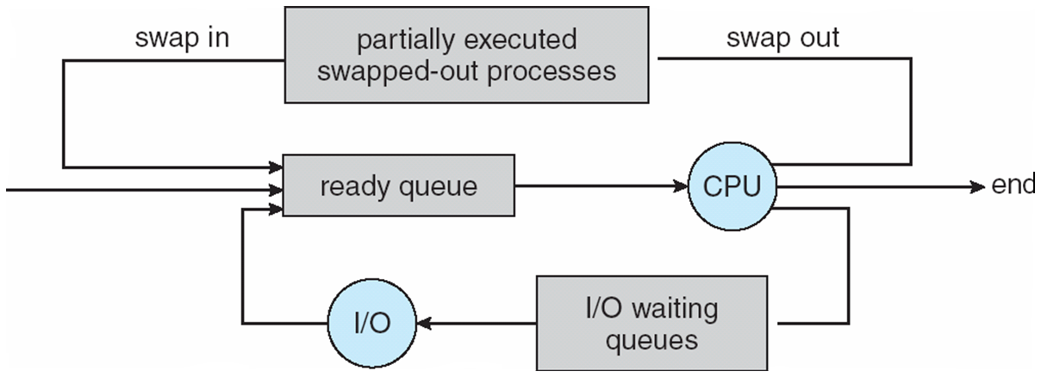
Schedulers
Medium-term scheduler can be added in time sharing systems if degree of multiprogramming needs to decrease
Intermediate level of scheduling
Swapping
Required for improving process mix or for freeing of memory

Slide 42
Thank You

